Slide 1
Assessing the Potential Impact of the New Tax Law on Housing & Food Expenditure
Rodrigo de las Casas
Github repo for this assignment (including data, code, & figs):
https://github.com/roddlc/telling_stories_with_data/tree/master/Assignment%20Submissions/Assignment%202

Slide 2
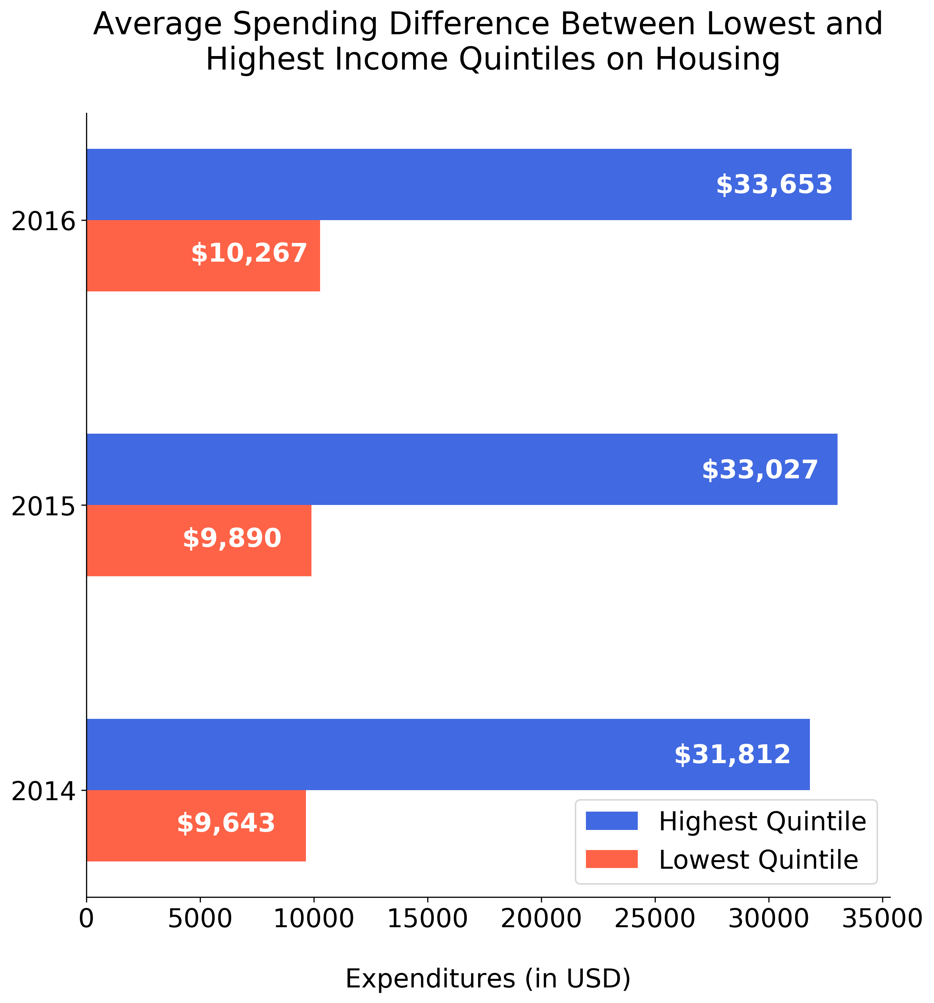
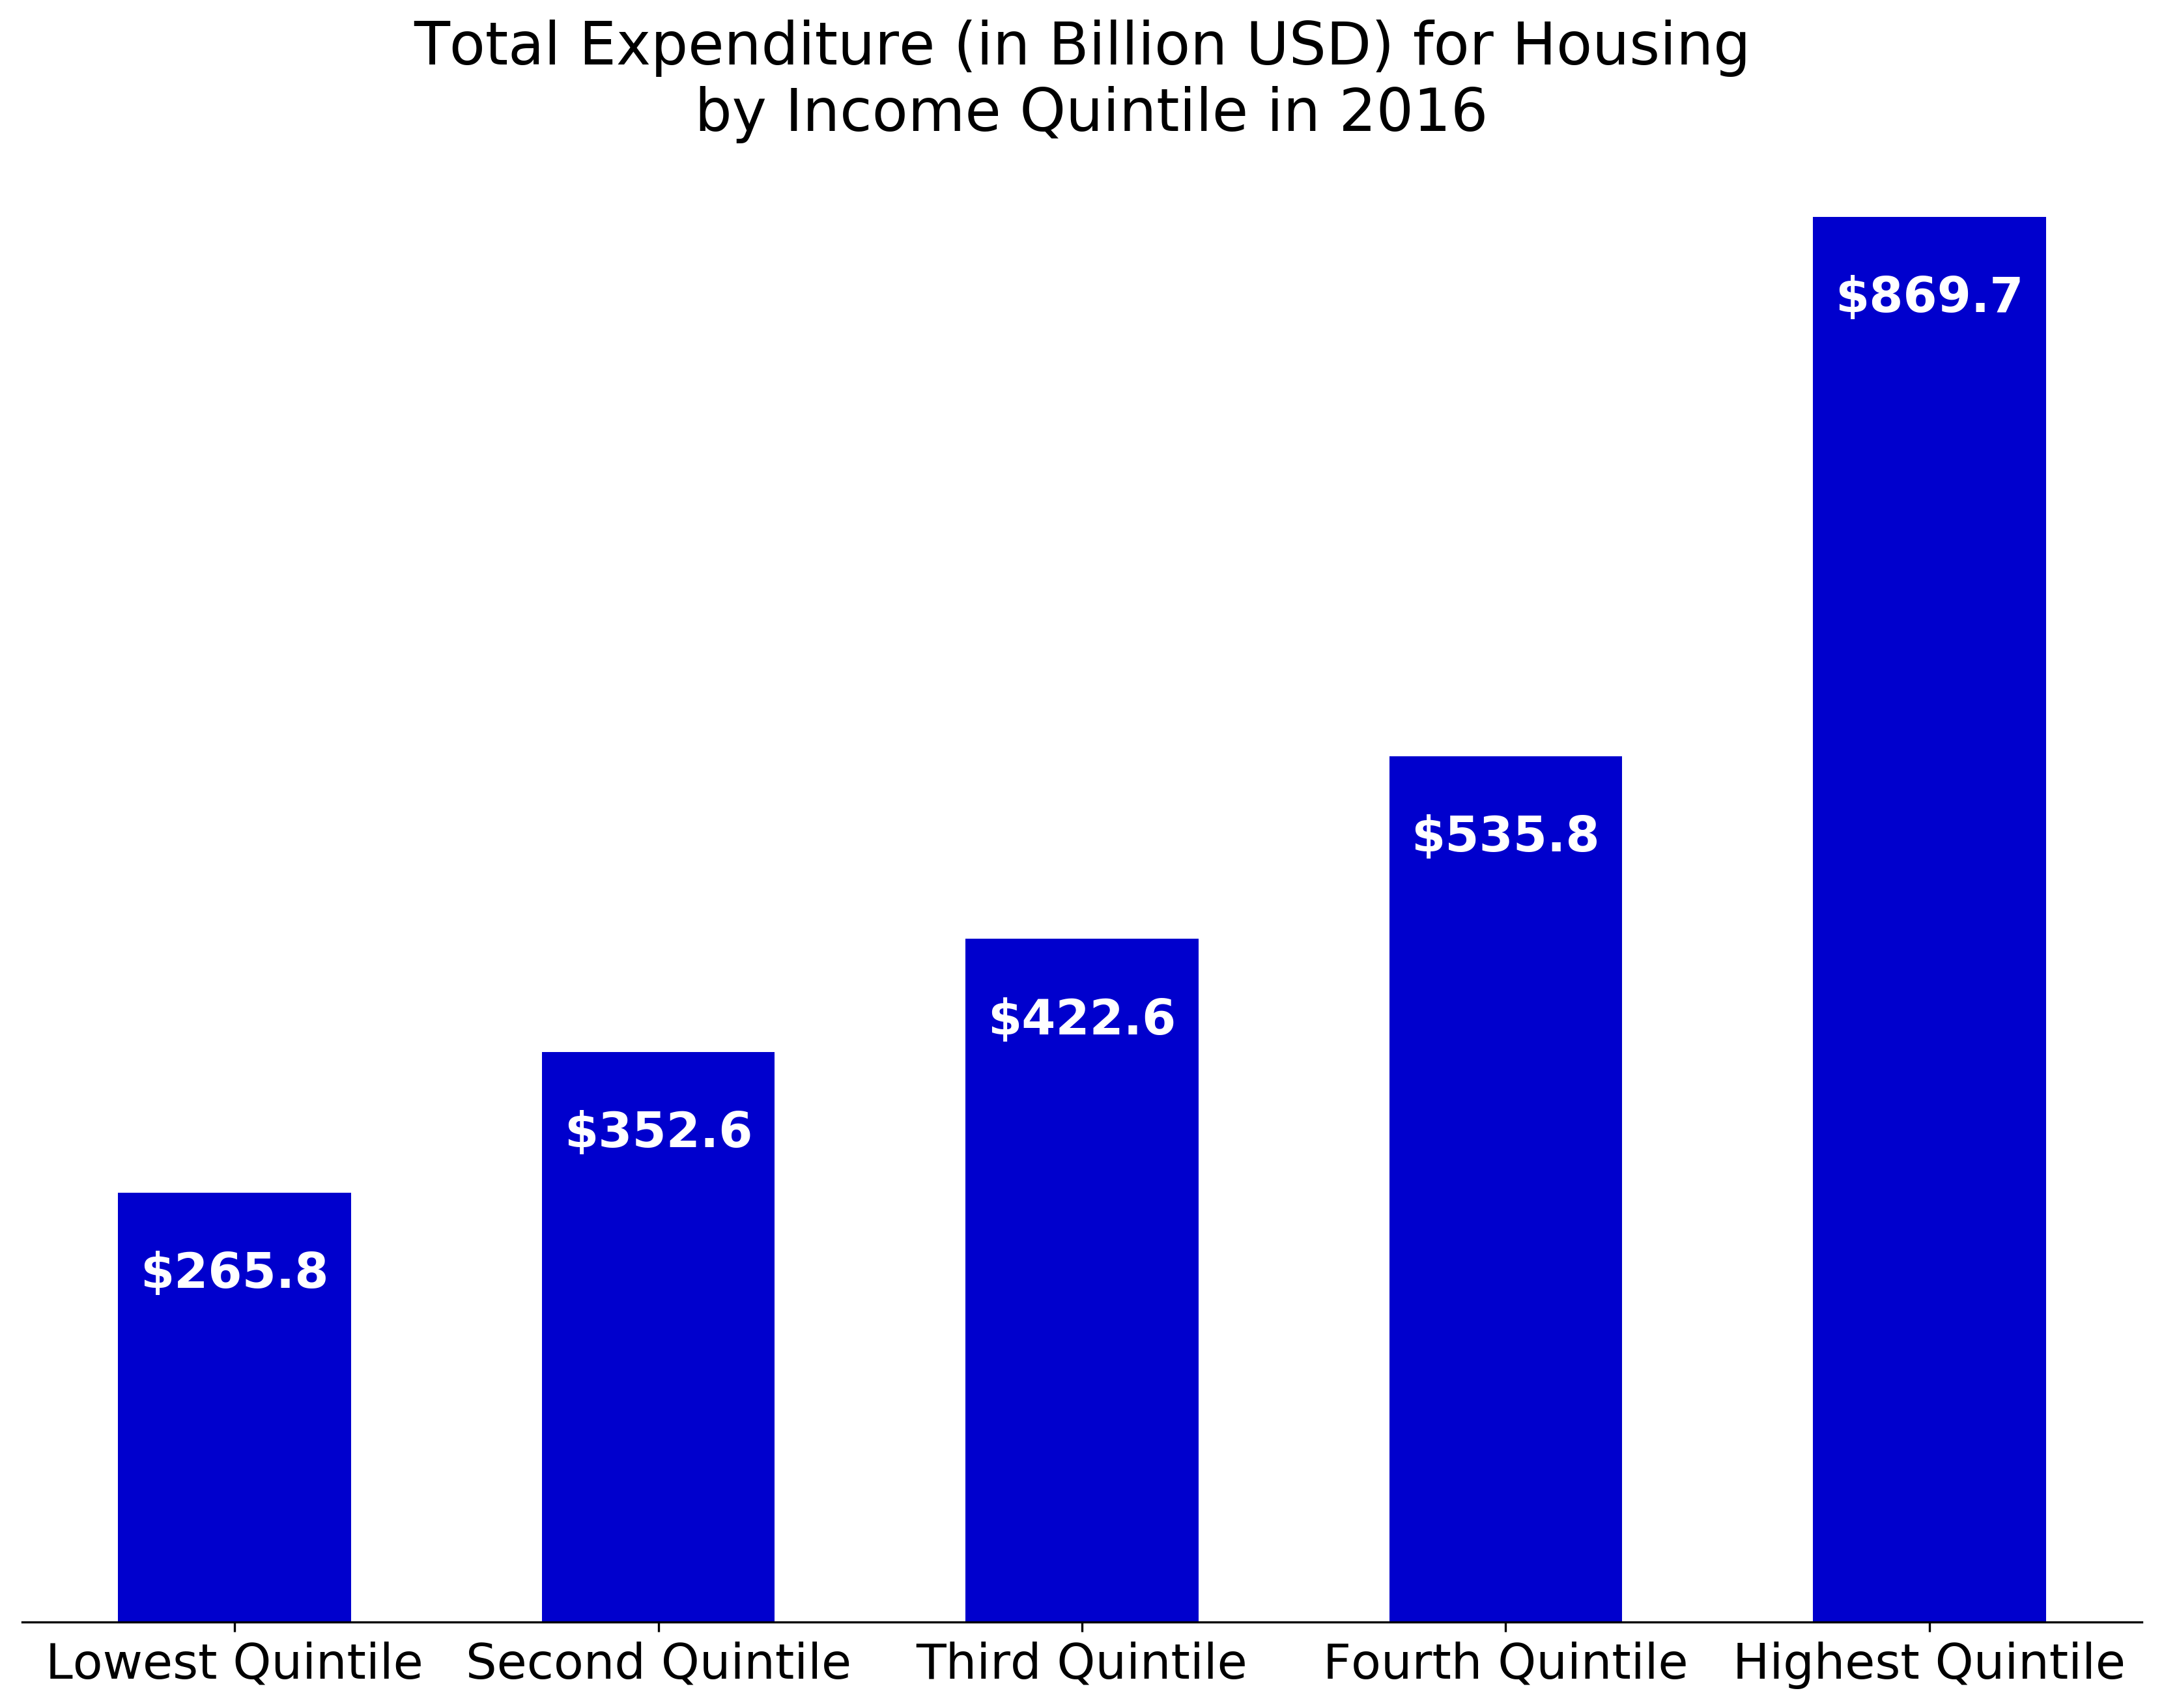
There is a significant difference between the highest and lowest income quintiles
Not surprisingly, the highest income quintile spends the most on housing.
However, it is worth noting just how much more the highest quintile spends relative to the lowest quintile, and even the fourth quintile.

Slide 3
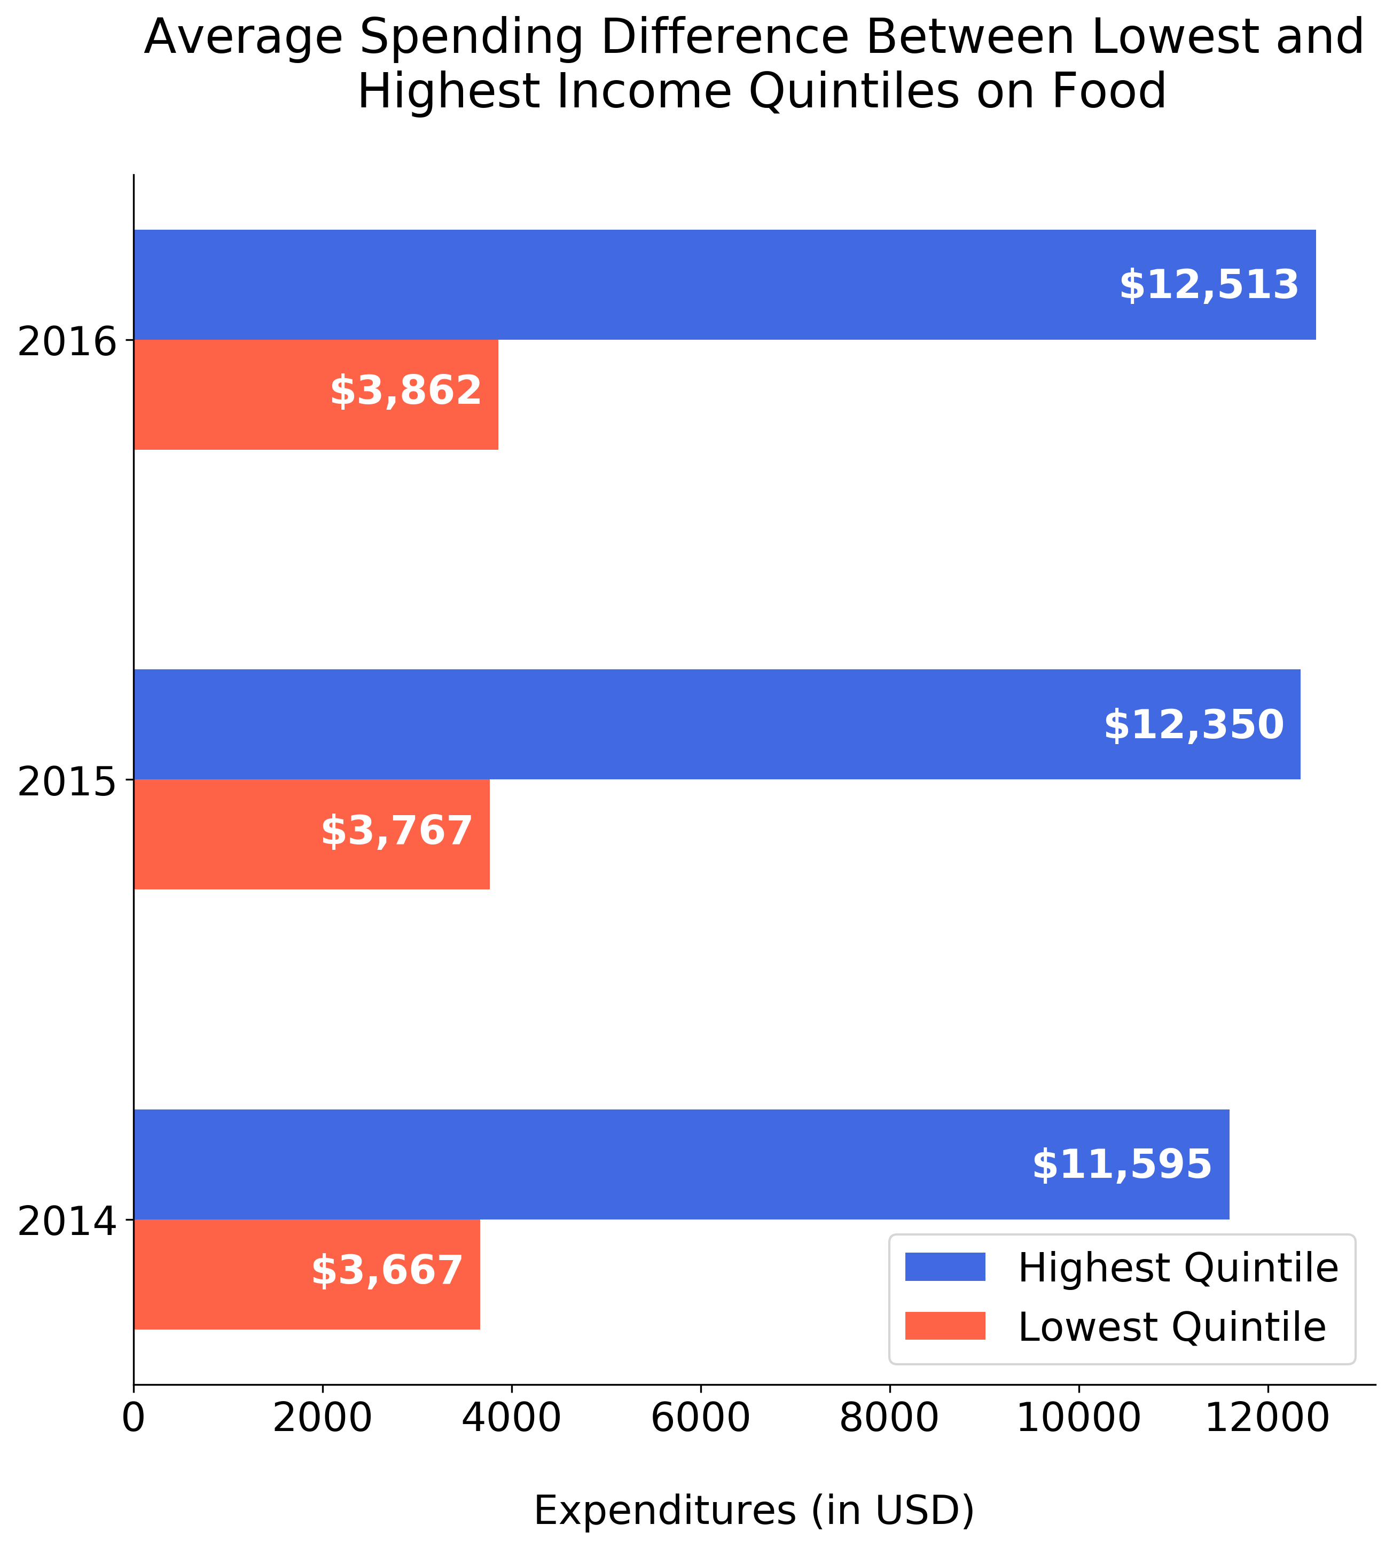
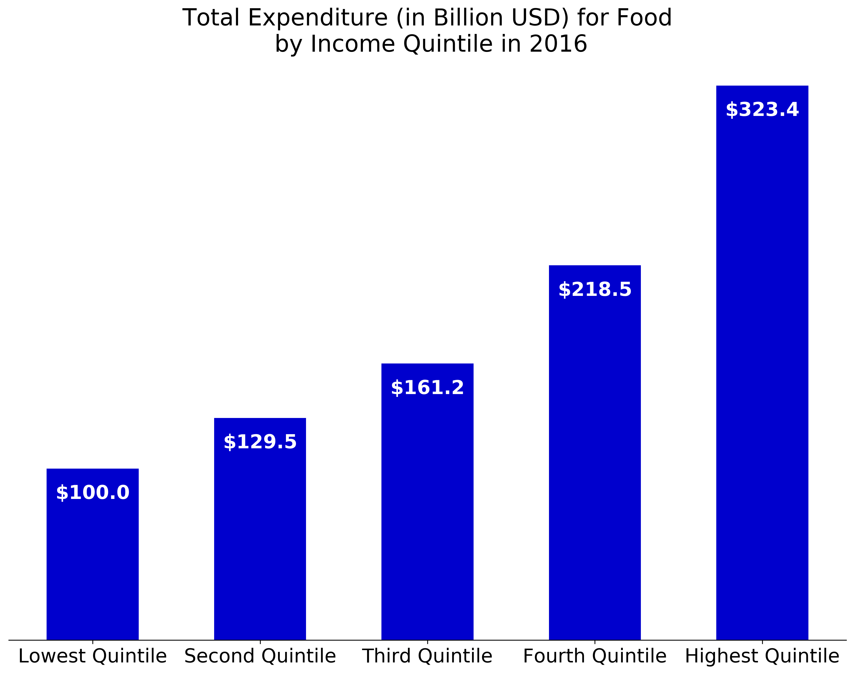
There is also a significant difference in spending between higher and lower income quintiles on food
Similarly, the highest income quintile spends much more on food.
As with the previous slide, it is worth that the highest income quintile spends far more on food when compared with the other quintiles, especially the lowest.

Slide 4
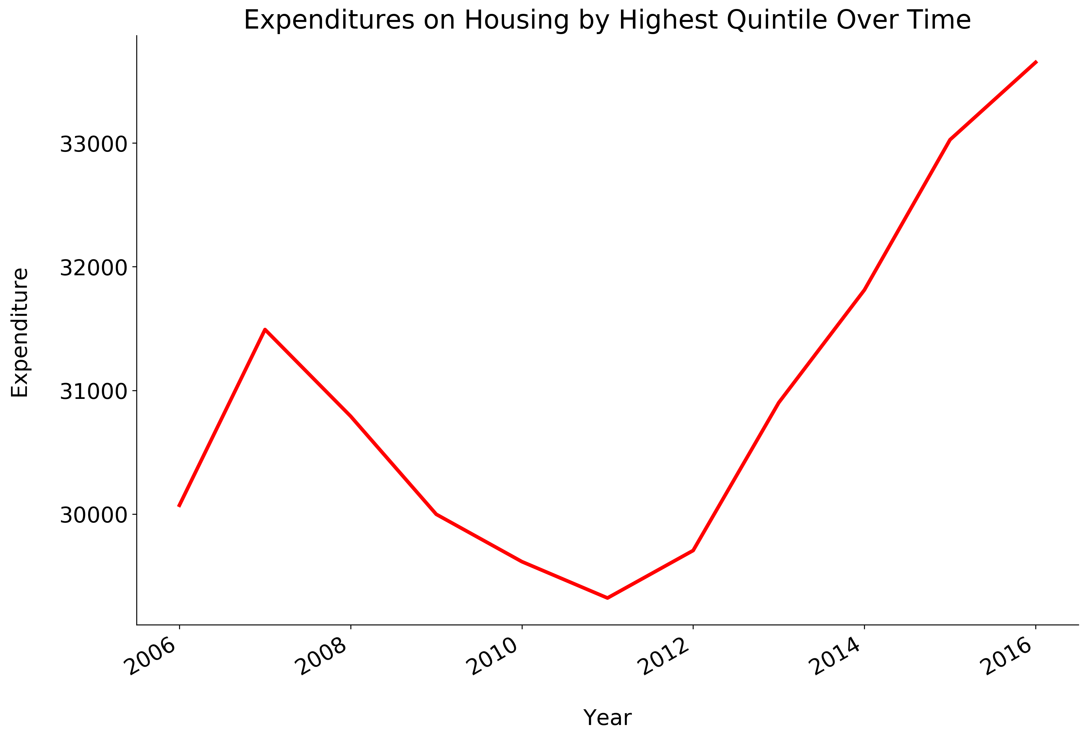
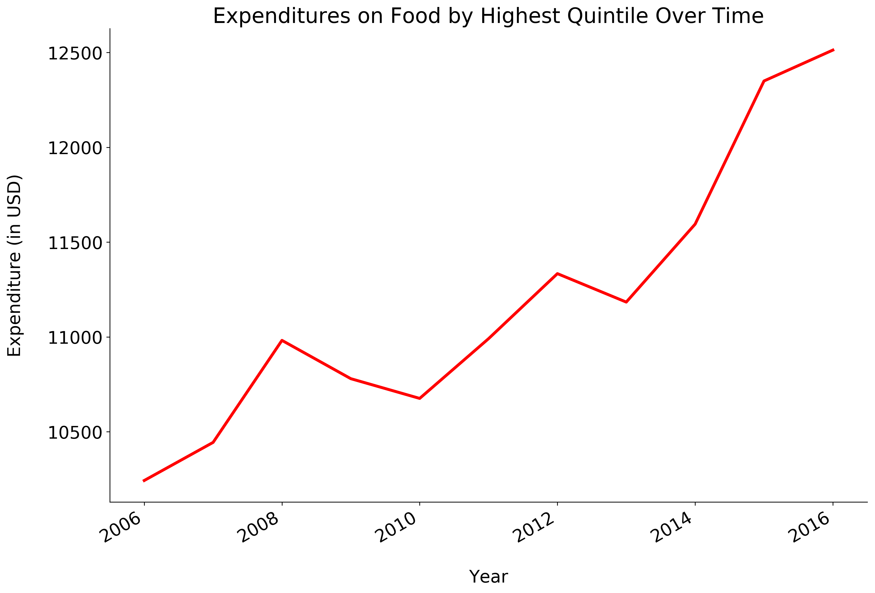
Expenditures on food and housing by the highest income quintile have also been trending up
In addition to the significant expenditures on housing and food, the highest income quintile has been consistently increasing its spending more on these two items, in contrast to other items (e.g., transportation).
The trend is mostly uninterrupted since the end of the most recent recession.

Slide 5
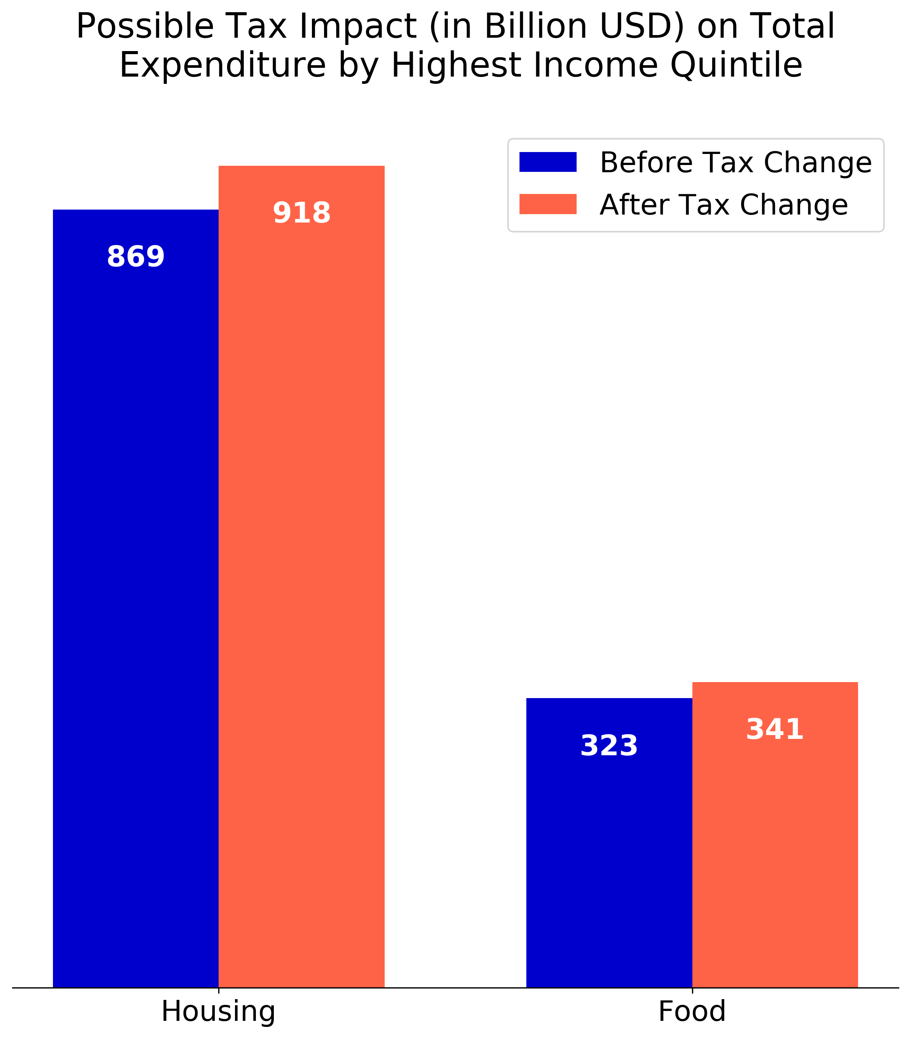
The tax bill disproportionately benefits the highest income quintile
Consumer Unit | Mean Income Before Tax | 2017 Tax | 2018 Tax | Tax Saving
Lowest Quintile | $11,389.00 | $1,138.90 | $1,138.90 | $0.00
Second Quintile | $28,976.00 | $3,413.75 | $3,042.00 | $371.75
Third Quintile | $50,563.00 | $6,651.80 | $5,686.44 | $965.36
Fourth Quintile | $84,173.00 | $12,520.35 | $10,396.72 | $2,123.63
Highest Quintile | $198,674.00 | $42,512.69 | $36,206.18 | $6,306.51
The highest income quintile benefits disproportionately from the tax law signed by President Trump at the end of 2017.
Assuming the highest quintile spends the same proportion of their income on housing and food, expenditures on these two items may rise by billions of dollars in 2018.
Given the consistent, upward trend in spending in these two areas by the highest income quintile, it seems logical to expect that they will use some of the newfound tax savings on both food and housing.
Companies providing services in these two areas to higher income customers could experience higher earnings in 2018.

